Slide 1
Note 7
The Relational Algebra
CSC134
Dr. Haiquan Chen

Slide 2
The Relational Algebra
Relational algebra
  A set of operators defined on the relational data model
Why to learn it?
  SQL statements only specify what data to retrieve
  Using relational algebra, you can specify (1) what data to retrieve and (2) how to retrieve it
Think relational algebra as an execution plan for each SQL query

Slide 3
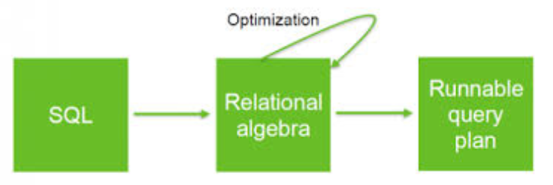
The Relational Algebra
  An internal module in DB (Query Compiler) translates each SQL query statement to its relational algebra expression before its execution in DB.
  There could be more than one possible relational algebra expression, given a SQL query statement.
  Different algebra may lead to different efficiencies of executing a given query

Slide 4
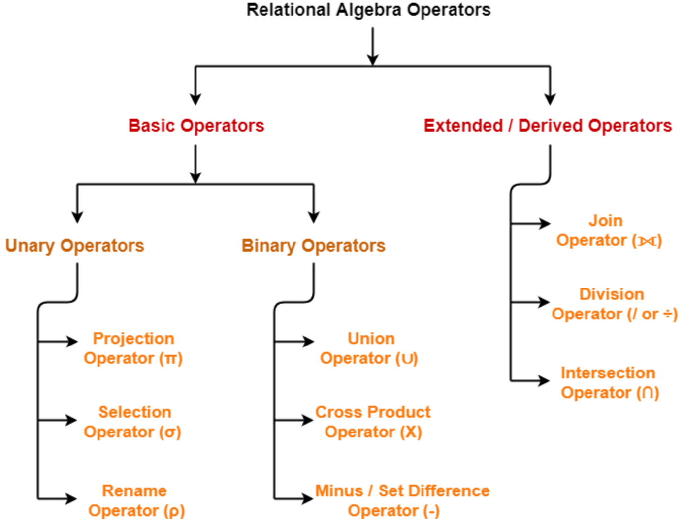
Relational algebra

Slide 5

SELECT operator
The SELECT Operator
  Returns a subset of the tuples from a relation that satisfies a selection condition:
  Selection condition should be of the form <condition> AND/OR <condition>...AND/OR <condition>

Slide 6
WHERE clause results in a SELECT operation
SELECT *
FROM EMPLOYEE
WHERE (Dno =4 AND Salary > 25000) OR (Dno =5 AND Salary > 30000)

Slide 7

PROJECT Operator
Give you a subset of columns from a table:
Duplicates are eliminated in PROJECT operation.

Slide 8

SELECT clause results in a PROJECT operation
SELECT Fname, Lname, Salary
FROM EMPLOYEE
WHERE Dno =5

Slide 9

The RENAME Operation
You may rename a relation or a column using Rho
Rename operator (Rho)

Slide 10
Relational Algebra Operations
UNION, INTERSECTION, and MINUS
  Merge the elements of two sets
  Two operand relations must have the same type of tuples
UNION
  R ∪ S
  Includes all tuples that are either in R or in S or in both R and S
  Duplicate tuples eliminated

Slide 11
Relational Algebra Operations
INTERSECTION
  R ∩ S
  Includes all tuples that are in both R and S
SET DIFFERENCE (or MINUS)
  R – S
  Includes all tuples that are in R but not in S

Slide 12

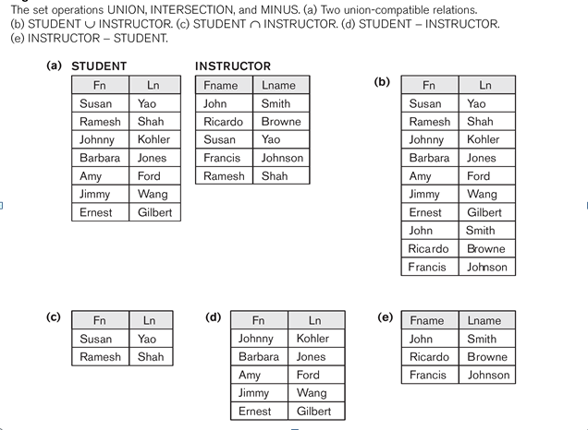

Slide 13
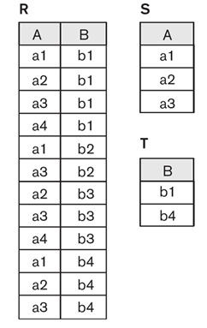
The DIVISION Operation
Denoted by ÷ or /
  R/S will return all the tuples where every S attribute value is in R
How to perform division?
  Schema(R/S) = Schema(R) - Schema(s)
  All the combinations of S must be in R
  No duplicates in the result

Slide 14
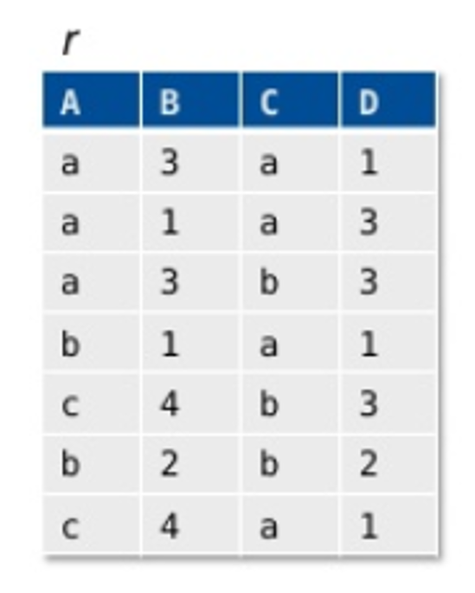
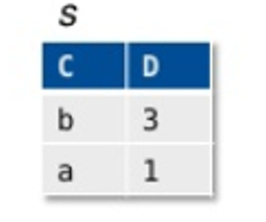
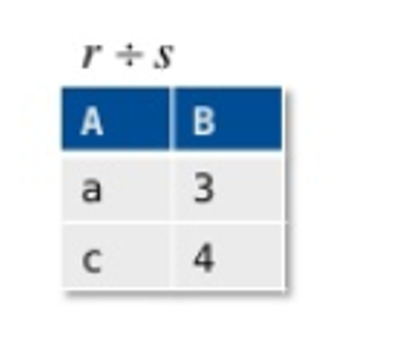

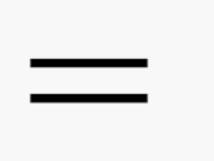
In-class practice

Slide 15
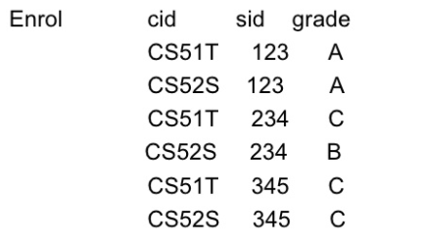
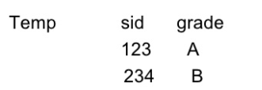
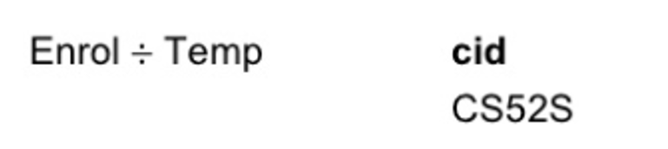
Why we need DIVISION?
Find all the courses where 123 got an A and 234 got a B:

Slide 16
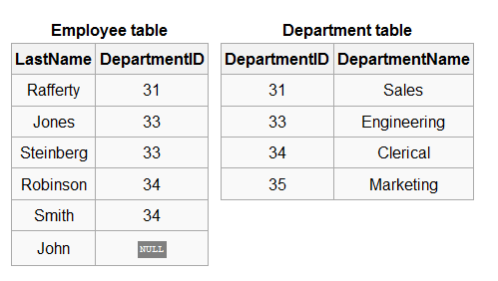
CROSS JOIN
CROSS JOIN (CROSS PRODUCT)
  Denoted by ×
  Produces the rows which combine each row from the first table with each row from the second table

Slide 17
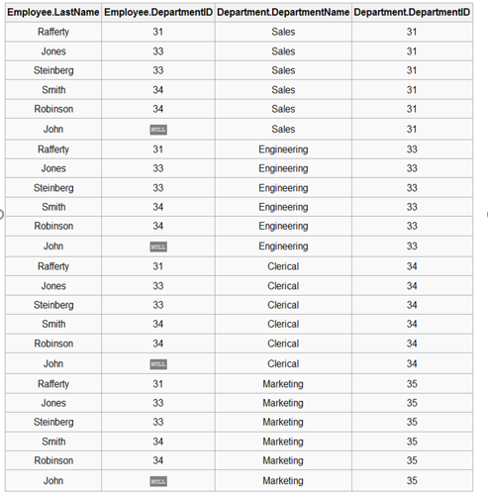

Slide 18

FROM clause in SELECT statement results in cross join

Slide 19

Inner JOIN (JOIN)
The Inner JOIN Operation
  Denoted by
  Each join has two steps:
    (1) Give you the cross join of the two tables
    (2) Apply a SELECT operation on the cross join
  The selection operation used here is called JOIN Condition:
    of the form <condition> AND/OR <condition>...AND/OR <condition>

Slide 20
Inner JOIN
Employee Department
Employee.DepartmentID > Department.DepartmentID
Join condition

Slide 21



Slide 22
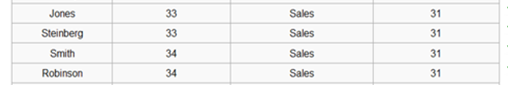
Employee Department
Employee.DepartmentID > Department.DepartmentID

Slide 23
EQUI-JOIN
EQUI-JOIN
  An Inner JOIN where only equation is used in the condition
  The EQUI-JOIN result has at least one pair of columns that have identical values in every tuple

Slide 24
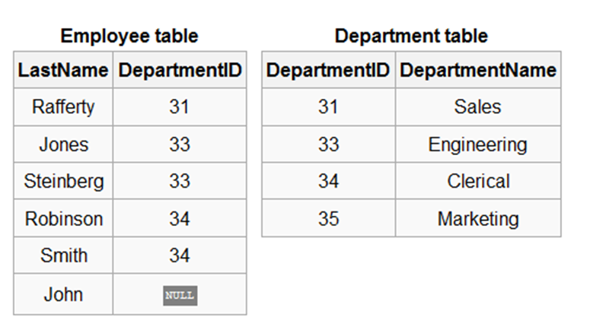
Employee Department
Employee.DepartmentID = Department.DepartmentID
Join condition

Slide 26
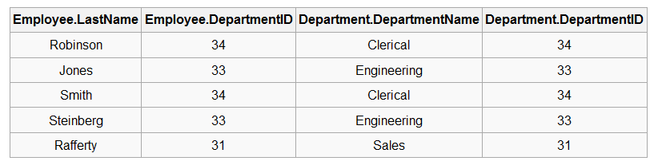
Employee Department
Employee.DepartmentID = Department.DepartmentID

Slide 27
Equation condition in WHERE clause results in Equijion.

Slide 28
NATURAL JOIN
NATURAL JOIN
  Denoted by *
  Applies to two relations with at least one pair of columns having the same name
  Natural join performs an EQUIJOIN first and then removes the second (redundant) columns in the EQUIJOIN result

Slide 29
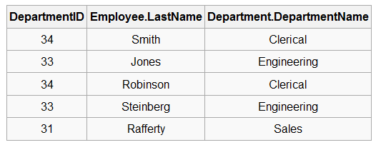
Employee * Department

Slide 30
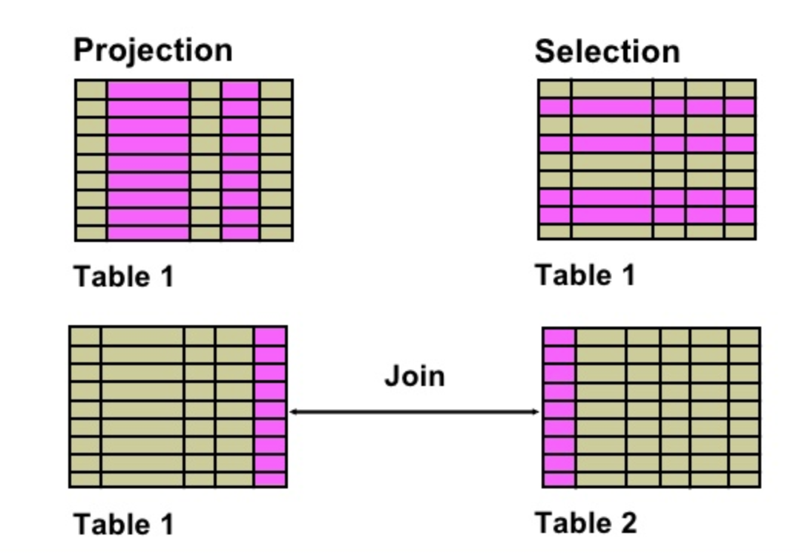
Takeaway: Projection vs Selection vs Inner Join

Slide 31
Ensure INNER JOIN in SQL
(Implicit Join) SELECT O.OrderID, C.CustomerName
FROM Orders O, Customers C
WHERE O.CustomerID = C.CustomerID;
is equivalent to:
(Explicit Join) SELECT O.OrderID, C.CustomerName
FROM Orders O
INNER JOIN Customers C
ON O.CustomerID = C.CustomerID;

Slide 32
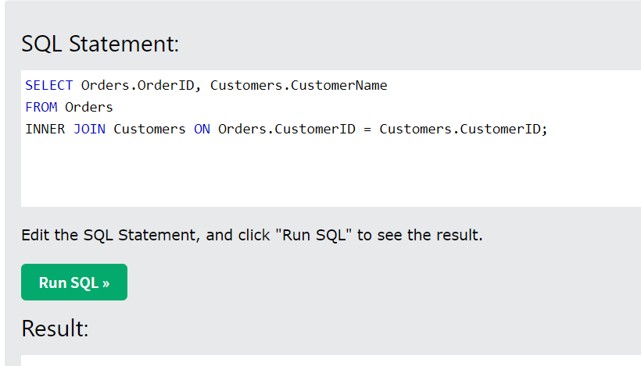
Demo
https://www.w3schools.com/sql/sql_join_inner.asp

Slide 33
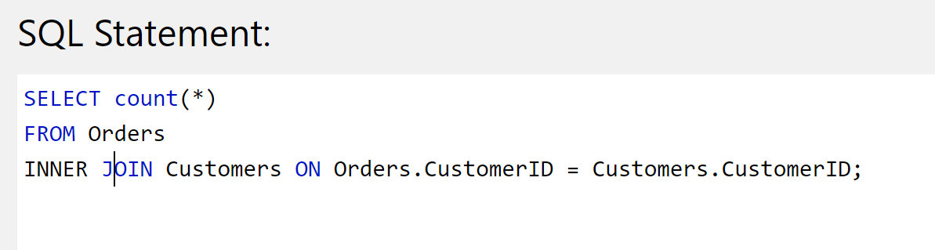
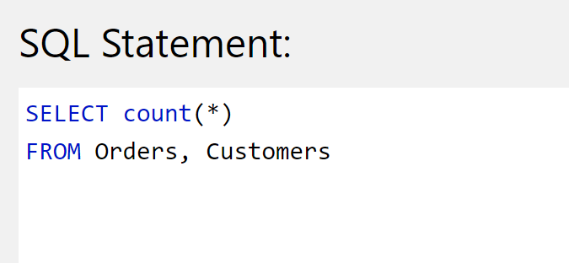
Equi- join vs Cross join

Slide 34
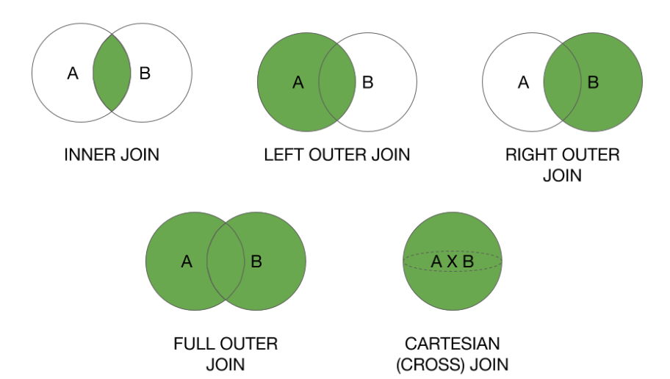
All join types
The INNER JOIN returns the tuples that have matching values in two relations (DEFAULT JOIN).

Slide 35
LEFT Outer JOIN
The LEFT Outer JOIN returns all records from the left table and the matched records from the right table. The result is NULL from the right table, if there is no match.

Slide 36
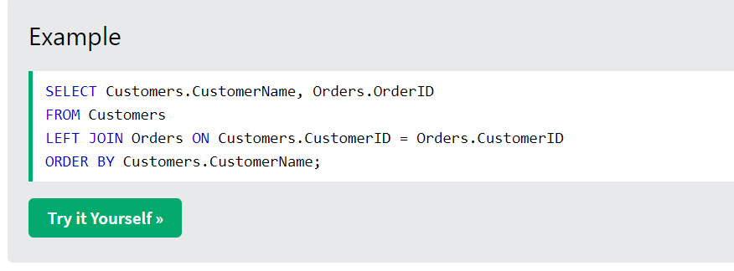
Demo
https://www.w3schools.com/sql/sql_join_left.asp

Slide 37
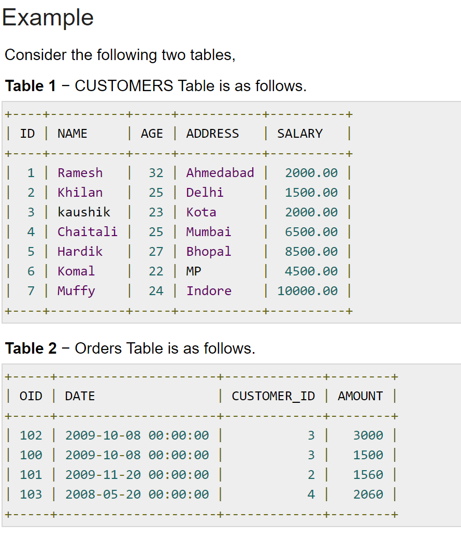
https://www.tutorialspoint.com/sql/sql-left-joins.htm

Slide 38
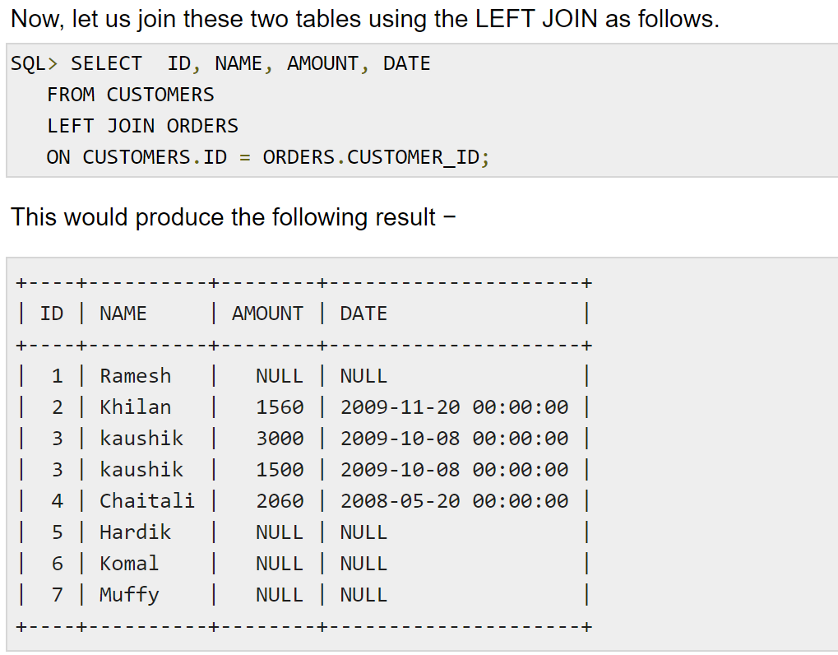

Slide 39
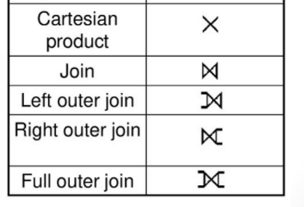
Symbols for JOIN

Slide 40
Relational Algebra Expression
Relational Algebra can be expressed using the following formats:
  Single in-line expression
  Multi-line Expression

Slide 41

Examples of Queries in Relational Algebra (Multi-Row Expression)
#1: Write relational algebra to retrieve first name, last name, and salary of all employees in the department 5.
Here we use left arrow (assignment operator) to create a new table to assign the intermediate result at each step.

Slide 42
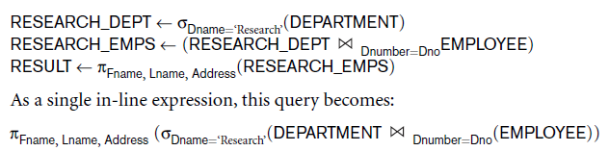
Examples of Queries in Relational Algebra (Multi-Row Expression)
#2: Retrieve first name, last name, and address of all employees in the “Research” department.

Slide 43
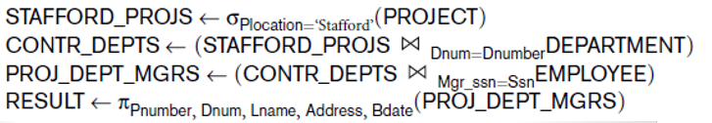
Examples of Queries in Relational Algebra (Multi-Row Expression)
#3: For every project located in “Stafford”, retrieve the project number, the controlling department number, and the department manager’s last name, address, and birth date.

Slide 44
Note
Whenever you use join, don't forget to specify the join condition

